Slide 1

Complementary and Supplementary Angles
BY Kush Patel
Date: 7/5/19
Click the Audio Icon

Slide 2
What will we learn today Click on the audio icon to learn more about the lesson:
Today we will be learning about Complementary Angles and Supplementary Angles. We will be doing 2 example problems and we will be going over all the steps on how to work these 2 problems. We will do One Complementary Angle problem and One Supplementary Angle problem. We will also be learning about Adjacent Angles.

Slide 3
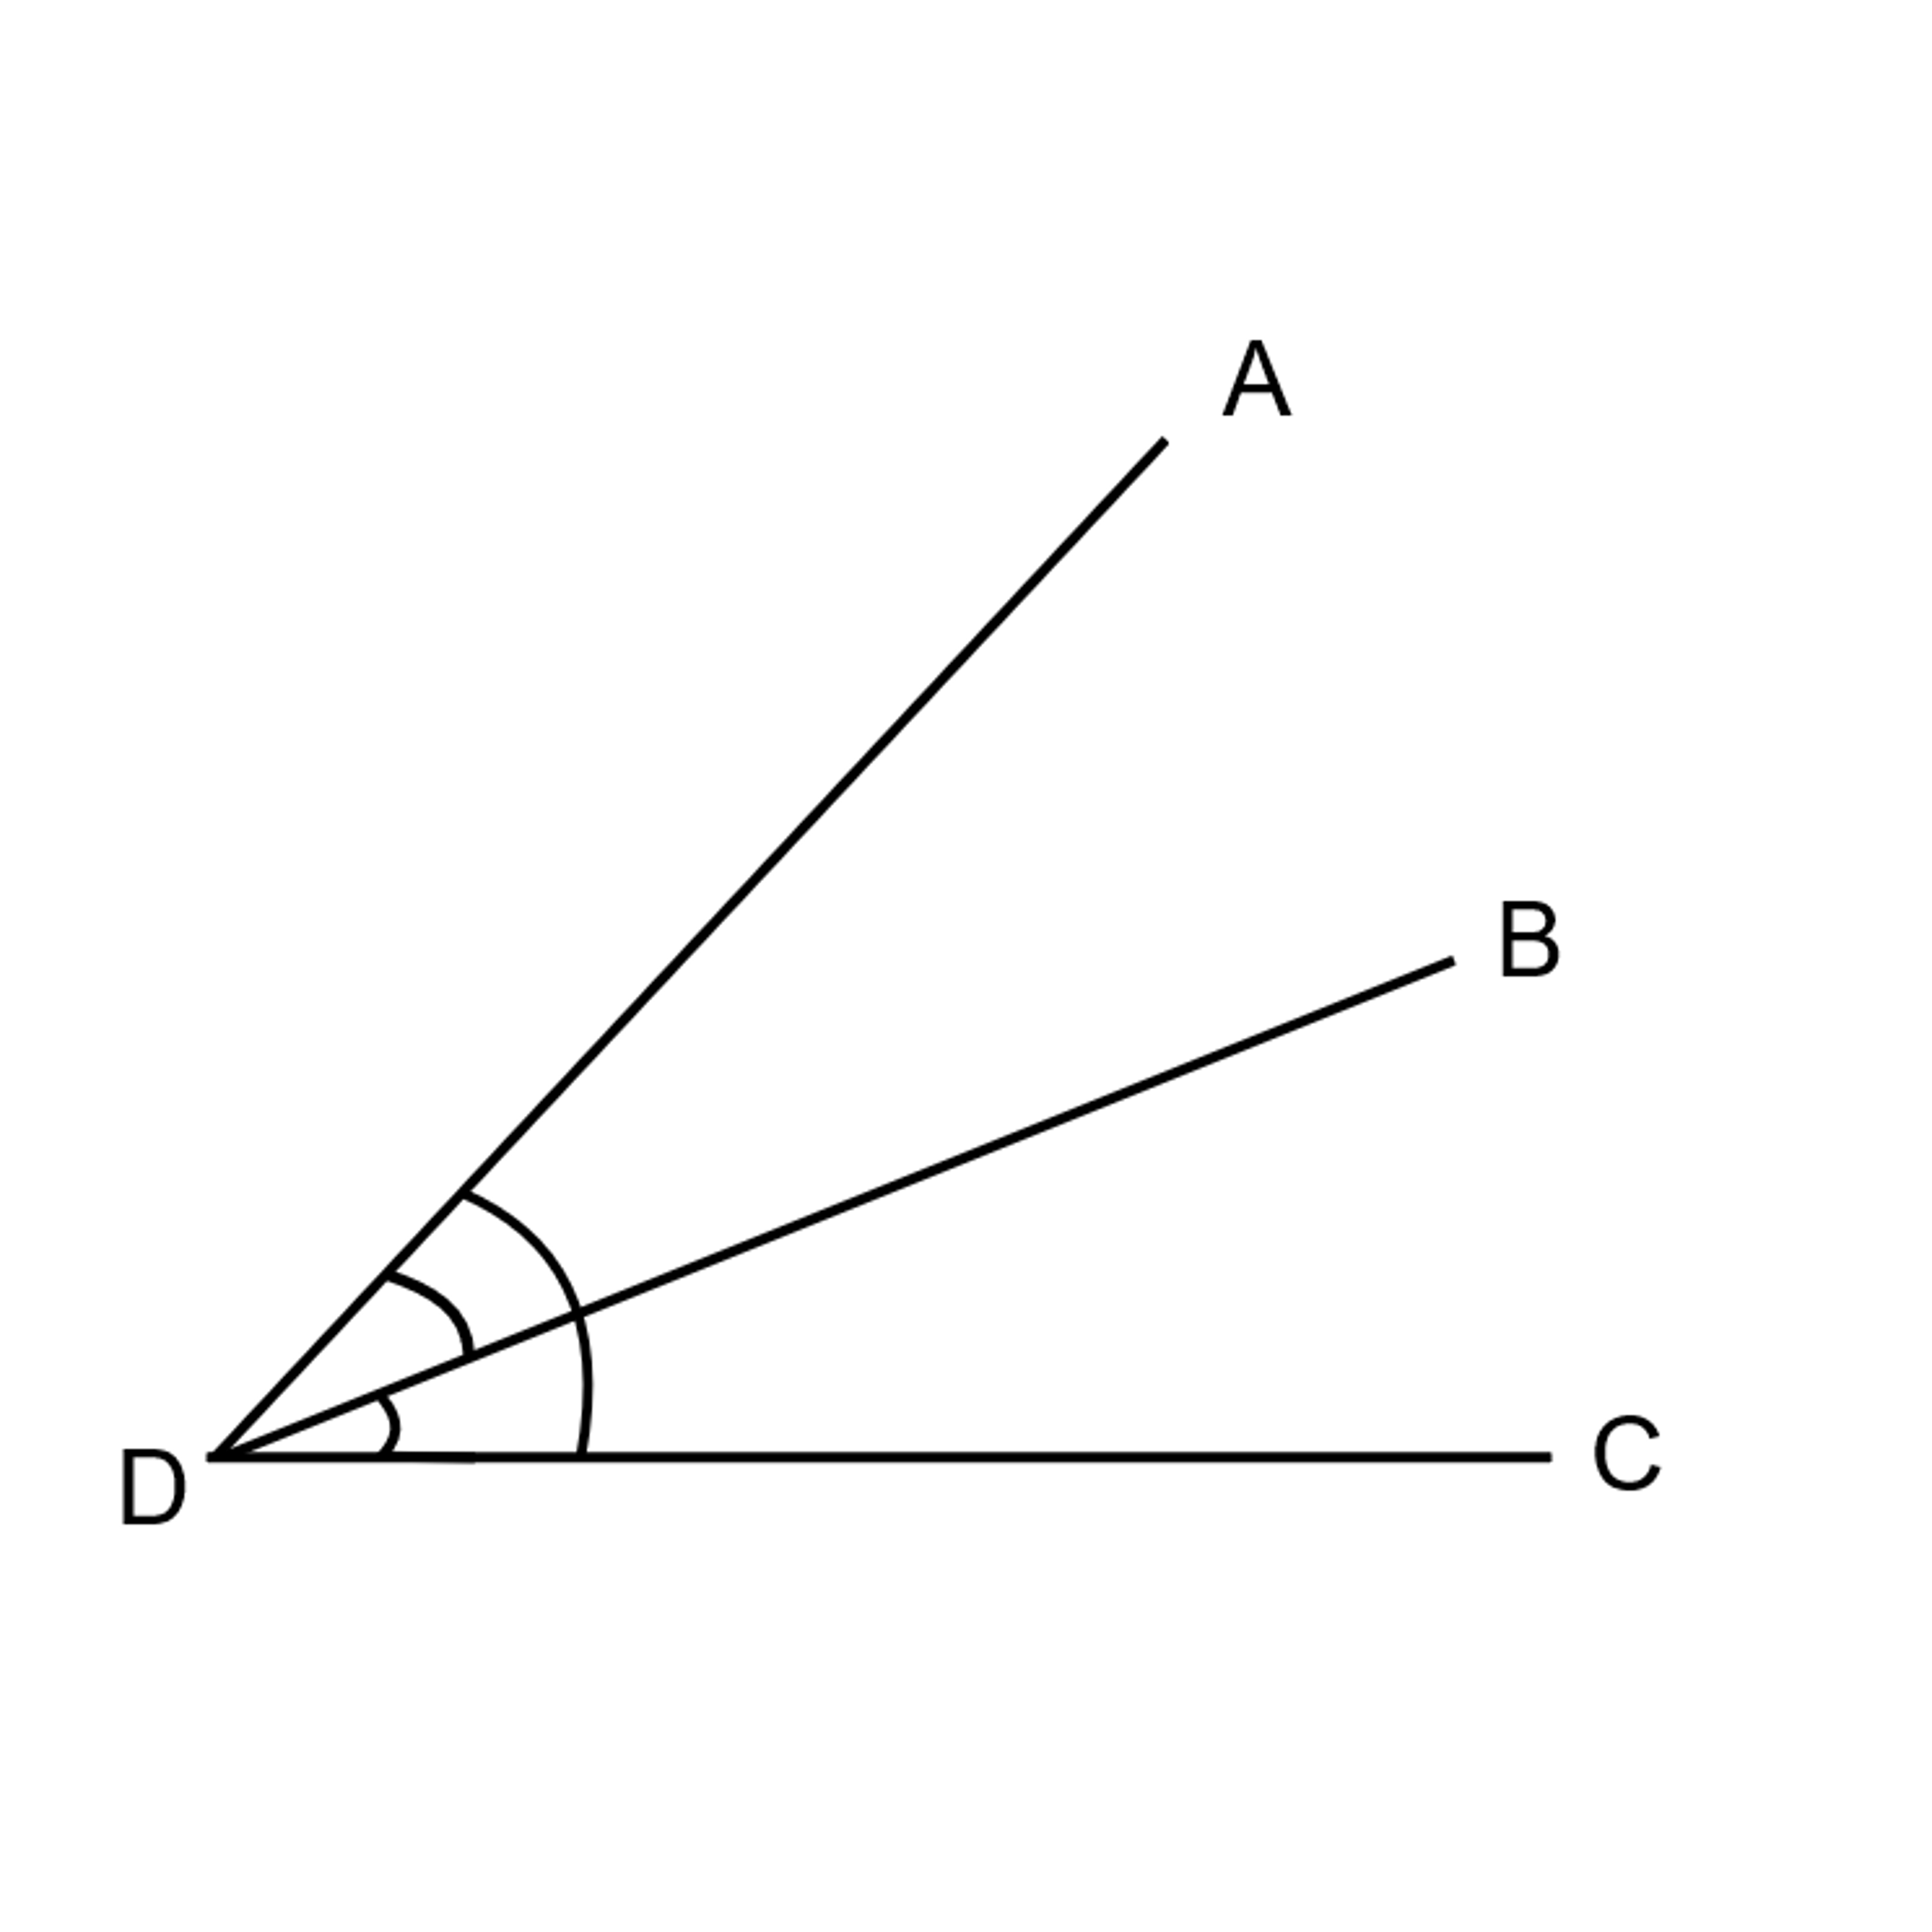
Adjacent Angles
Click on the audio icon to learn/hear the lesson:
Example
Adjacent Angles are two angles that are next to each other with the same vertex

Slide 4


Complementary Angles
Complementary Angles are two adjacent angles that add up to 90 °
Click on the audio icon to learn/hear the lesson:
Example:
∠CAD = 25°
∠DAB = 65°
∠CAB is a Right Angle which means it’s a Complementary Angle
D
∠CAD° + ∠DAB =90
25°+ 65°=90°
∠CAD and ∠DAB form a new angle ∠CAB
∠CAB= 90°
C
25°
65°
∠CAD and ∠DAB are both adjacent to each other and have the same vertex
A
B

Slide 5


Supplementary Angles
Supplementary Angles are two adjacent angles that add up to 180 °
Click on the audio icon to learn/hear the lesson:
G
Example:
∠GED = 125°
∠GEF = 55°
∠GED +∠GEF = 180 °
F
D
125° + 55°=180°
E
∠GED and ∠GEF form a new angle ∠FED
∠FED=180 °
∠FED is a straight line or a straight angle which is supplementary

